Slide 1
Working with the Touch Screen Display

Slide 2
In Android mode, we can also use the following mouse methods, which are available in all Processing modes. The Android touch screen gestures correspond to the following mouse events:
mousePressed() This callback method is called every time a finger touches the screen panel. It corresponds to a mouse-pressed event on the desktop when the mouse button is pressed down.
mouseReleased() This callback method is called every time a finger lifts off the touch screen surface, but only if its position has changed since first touching the panel. It corresponds to a mouse-up event on the desktop.
mouseDragged() This callback method is called every time a new finger position is detected by the touch screen panel compared to the previously detected position. It corresponds to a mouse-dragged event on the desktop when the mouse moves while the button is pressed.+

Slide 3
void draw()
{
// no display output, so nothing to do here
}
void mousePressed ()
{
println("PRESSED x:" + mouseX + " y: " + mouseY);
}
void mouseReleased ()
{
println("RELEASED x:" + mouseX + " y: " + mouseY);
}
void mouseDragged ()
{
println("DRAGGED x:" + mouseX + " y: " + mouseY);
}
Run the App
PRESSED x:125 y:208
DRAGGED x:128 y:210
DRAGGED x:130 y:209
RELEASED x:130 y:209

Slide 4
Using Colors
Here are the parameters colorMode() can take. We can specify mode as either RGB or HSB and specify range in the value range we prefer.
colorMode(mode)
colorMode(mode, range)
colorMode(mode, range1, range2, range3)
colorMode(mode, range1, range2, range3, range4)
Processing provides us with two different color modes that we can switch between using the colorMode() method. The color mode can be set to RGB or HSB (hue, saturation, brightness), which we'll explore further in Using HSB Colors. colorMode() changes the way Processing interprets color values. Both RGB and HSB can handle alpha values to make objects appear transparent.+

Slide 5
Using Grayscale and RGB colors
One parameter results in a grayscale value.
Two parameters define a grayscale and its opacity (as set by an alpha value). If alpha is set to 0, the color is fully transparent. An alpha value of 255 results in a fully opaque color.
Three parameters correspond by default to red, green, and blue values.
Four parameters contain the red, green, and blue values and an alpha value for transparency.
fill(gray)
stroke(gray)
background(gray)
fill(gray, alpha)
stroke(gray, alpha)
fill(red, green, blue)
stroke(red, green, blue)
background(red, green, blue)
fill(red, green, blue, alpha)
stroke(red, green, blue, alpha)

Slide 6
Using HSB Colors
fill(hue, saturation, brightness)
stroke(hue, saturation, brightness)
background(hue, saturation, brightness)
fill(hue, saturation, brightness, alpha)
stroke(hue, saturation, brightness, alpha)
we can access the hue directly using Processing's hue() method. It takes a color as a parameter and extracts only the hue value of that color. Similarly, we can get the brightness by using the brightness() color method, and we can access the saturation() separately as well. The HSB color cylinder is a very useful illustration of this color space to further investigate and better understand the HSB color mode, where all hues are represented within the 360-degree circumference of the color cylinder.

Slide 7
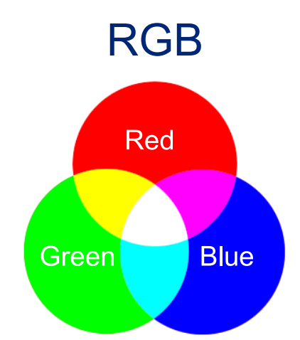
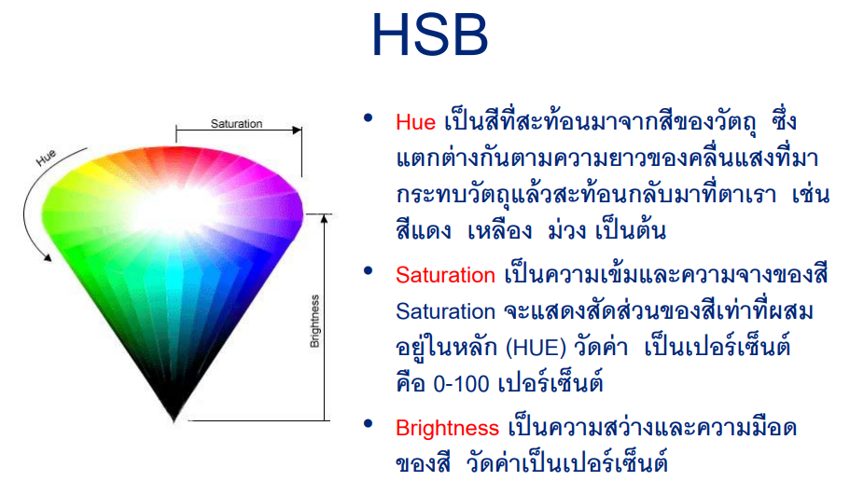
http://www.webblog.rmutt.ac.th/sakurajung/files/2011/09/color-theory.pdf

Slide 8
Use Mouse Speed to Control Hues
void setup()
{
noStroke();
background(0);
colorMode(HSB, 100, 1, 1); // 1
}
void draw()
{
fill(dist(pmouseX, pmouseY, mouseX, mouseY), 1, 1); // 2
ellipse(mouseX, mouseY, mouseX-pmouseX, mouseY-pmouseY);
}

Slide 9
Introducing the Ketai Library
Choose "Add Library...," which you can find under Sketch ↦ "Import Library..."
At the bottom of the window that opens, enter "Ketai."+
Select the Ketai library that appears in the list and press the Install button on the right.
The download starts immediately, and a bar shows the download's progress. When the library is installed, the button on the right changes to Remove.
The following classes are included in the library, described in more detail in ketai classes, and explained within the relevant chapters:
KetaiSensor
KetaiLocation
KetaiCamera
KetaiFaceDetector
KetaiBluetooth
KetaiWiFiDirect
KetaiNFC
KetaiData
KetaiList
KetaiKeyboard
KetaiGesture

Slide 10
import ketai.ui.*; // 1
import android.view.MotionEvent; // 2
KetaiGesture gesture; // 3
float rectSize = 100; // 4
float rectAngle = 0;
int x, y;
color c = color(255); // 5
color bg = color(78, 93, 75); // 6
void setup()
{
orientation(LANDSCAPE);
gesture = new KetaiGesture(this); // 7
textSize(32);
textAlign(CENTER, BOTTOM);
rectMode(CENTER);
noStroke();
x = width/2; // 8
y = height/2; // 9
}
Import Ketai's ui package to give us access to the KetaiGesture class.
Import Android's MotionEvent package.
Define a variable called gesture of type KetaiGesture.
Set a variable we call rectSize to 100 pixels to start off.
Define the initial color c (white), which we'll use as a fill color for the rectangle and text.
Define the initial color bg (dark green), which we'll use as a background color.
Instantiate our KetaiGesture object gesture.
Set the initial value for our variable x as the horizontal position of the rectangle.
Set the initial value for y as the vertical position of the rectangle.

Slide 11
Let's get started. This sketch works with the PHP script on the dedicated web server for this book project. If you point the serverURL variable to another destination, you'll store your locations there.
import ketai.sensors.*;
double longitude, latitude, altitude, accuracy;
KetaiLocation location; // 1
Location otherDevice; // 2
KetaiSensor sensor;
String serverMessage = "";
String myName = "myNexusID"; // 3
String deviceTracked = "myNexusID"; // 4
String serverURL = "http://ketaiLibrary.org/rapidAndroidDevelopment/location.php"; // 5
float compass;

Slide 12
void updateMyLocation()
{
if (myName != "")
{
String url = serverURL+"?update="+myName+
"&location="+latitude+","+longitude+","+altitude; // 7
String result[] = loadStrings(url); // 8
if (result.length > 0)
serverMessage = result[0];
}
}
https://www.mobileprocessing.org/geolocation.html

